Slide 1

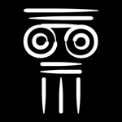
CREDIT CARD FRAUD DETECTION
Toshani Rungta (PES2UG19CS433) – CSE Dept.
Vismaya iyer (PES2UG19ec163) – ECE Dept.

Slide 2
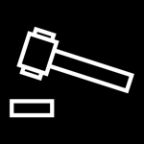
Problem addressed and reason for choosing
MENTIONED PROJECT CHOSEN BECAUSE
An interest in machine learning along with the guidance and mentorship available to understand some core concepts of data analysis and the meaning of various training methodologies as well as their uses in different scenarios
PROBLEM ADDRESSED
The project will be able to classify fraud transactions from the various credit card transactions.

Slide 3
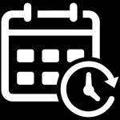
Methodology
Steps we followed/will perform during the course of the project
Choose the data set
Perform EDA using pandas
Perform Data Visualization using seaborn
Train the model using logistic regression
Test the model
CURRENT STATUS

Slide 4
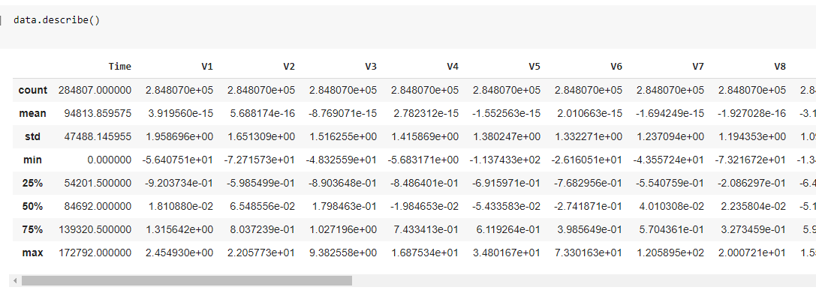
Where we left …
The data set had been chosen and explained. Partial EDA had been performed

Slide 5
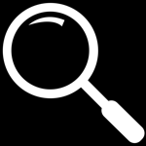
Further EDA
Correlation Matrix – A correlation matrix is a table showing correlation coefficients between sets of variables. Each random variable (Xi) in the table is correlated with each of the other values in the table (Xj).
Heat Map – A heat map (or heatmap) is a data visualization technique that shows magnitude of a phenomenon as color in two dimensions.

Slide 6
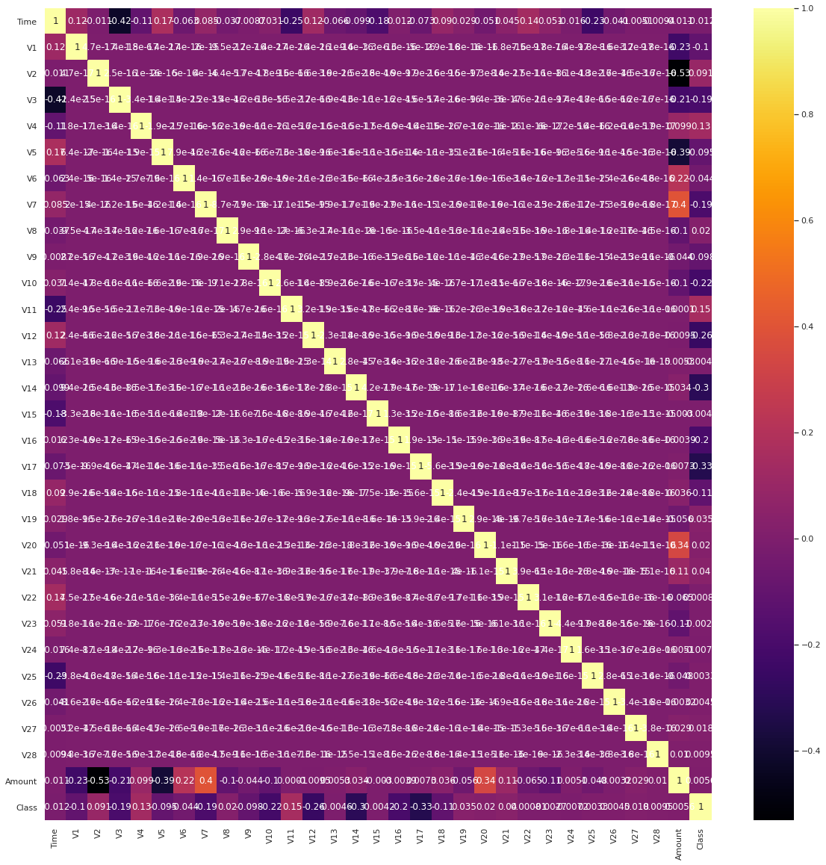
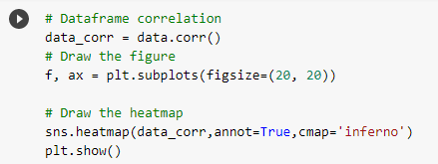
One heat map has been plotted for the complete data set to know the correlation of each column with the other.

Slide 7
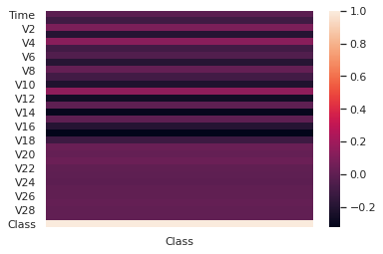
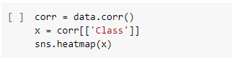
The other heat map is for the relation of Class wrt every other column to know their significance in affecting Class.

Slide 8
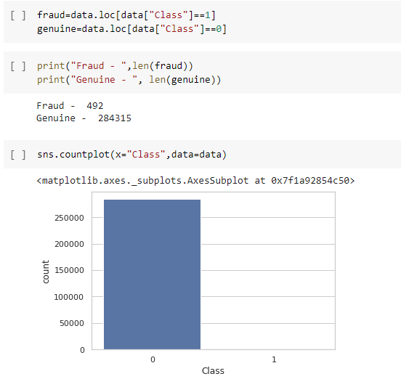
Checking for data imbalance
Since Class is the parameter that is going to be classified, hence, we check the statistics of the same.
We find that the data is highly imbalanced, with Genuine transactions being 99.83% and Fraud transactions being 0.17% .
The high imbalance observed results in a complex model being formed and causes overfitting of data which reduces precision.

Slide 9
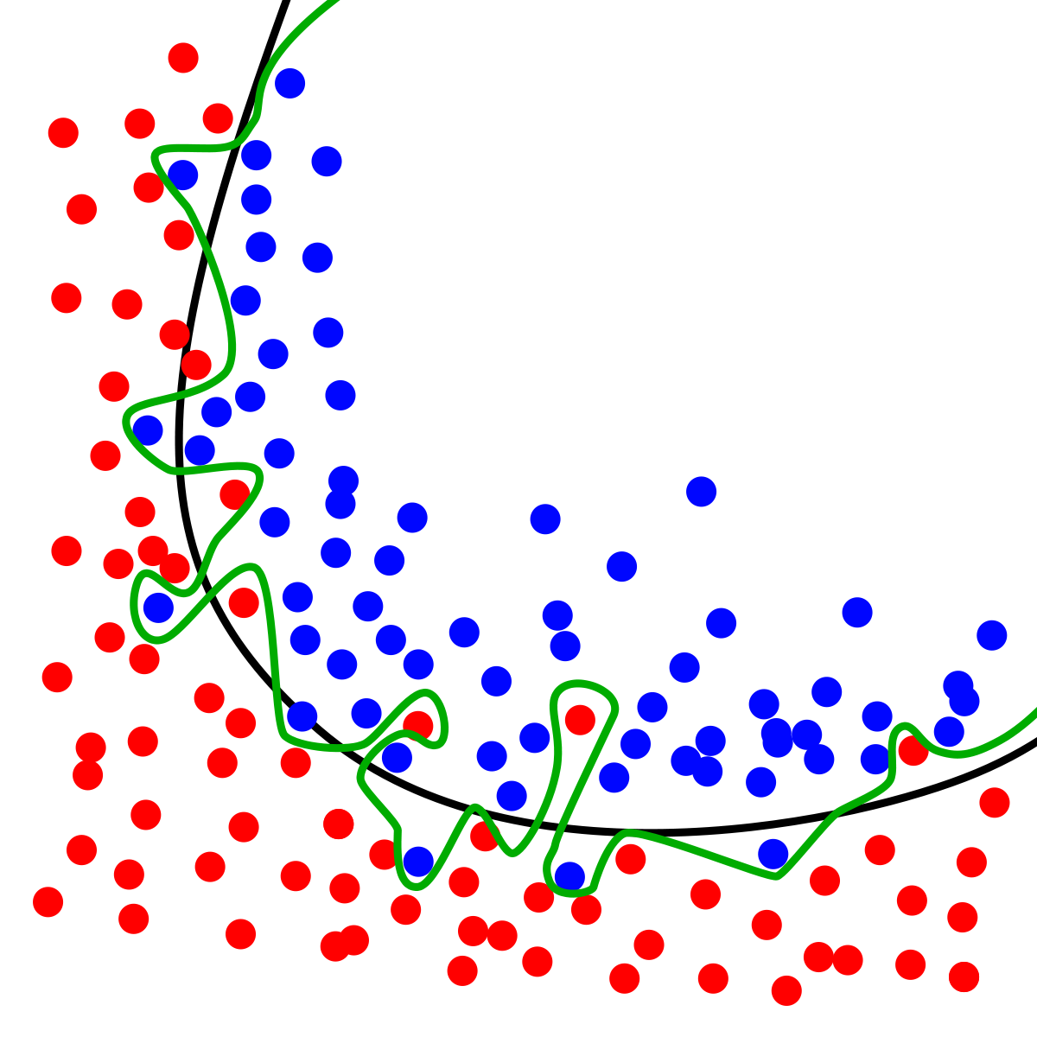
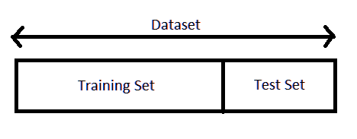
overfitting
Overfitting refers to a model that models the training data too well and doesn’t generalize well from our training data to unseen data/test data.
Overfitting can be detected by splitting the given dataset into train-test sets. If the accuracy of the model on the training set is much better than that on the test set, the model is over fitted.

Slide 10
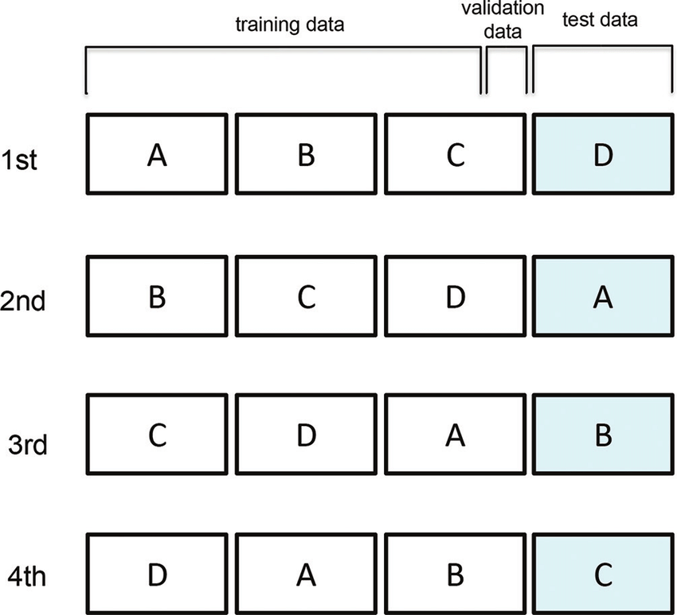
Cross validation
Cross-validation is a powerful preventative measure against overfitting. The initial data is split into k-folds, where the kth fold is used as the final test set while the remaining are divide into mini train-test sets that are used to tune the model.

Slide 11
NEXT STEP
Learning how to implement cross validation in python, deciding and learning the training model to implemented.
Since we are not solving data imbalance but rather the problem of overfitting caused by it, the programming implementation of the same can happen only when we implement the classification model.

Slide 12
THANK YOU!

